Slide 1
Support Vector Machine algorithm
Support Vector Machines are perhaps one of the most popular and talked about machine learning algorithms.
It is a supervised machine learning algorithm that can be employed for both classification and regression purposes. SVMs are more commonly used in classification problems
SVMs are based on the idea of finding a hyperplane that best divides a dataset into two classes, as shown in the image below.
Support vectors are the data points nearest to the hyperplane, the points of a data set that, if removed, would alter the position of the dividing hyperplane. Because of this, they can be considered the critical elements of a data set.
Notes:
Compare degrees of memberships in k-means and fuzzy c-means

Slide 2
Support Vector Machine algorithm
What is a hyperplane?
As a simple example, for a classification task with only two features (like the image above), you can think of a hyperplane as a line that linearly separates and classifies a set of data.
Intuitively, the further from the hyperplane our data points lie, the more confident we are that they have been correctly classified. We therefore want our data points to be as far away from the hyperplane as possible, while still being on the correct side of it.

Slide 3
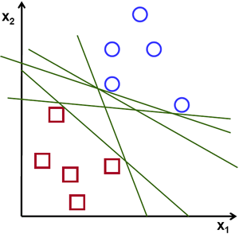
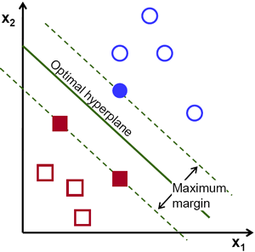
Support Vector Machine algorithm
The distance between the hyperplane and the nearest data point from either set is known as the margin.
The goal is to choose a hyperplane with the greatest possible margin between the hyperplane and any point within the training set, giving a greater chance of new data being classified correctly.

Slide 4
SVM Algorithm Uses
https://www.kdnuggets.com/2016/07/support-vector-machines-simple-explanation.html
https://towardsdatascience.com/support-vector-machine-introduction-to-machine-learning-algorithms-934a444fca47
https://machinelearningmastery.com/support-vector-machines-for-machine-learning/
http://www.statsoft.com/textbook/support-vector-machines

Slide 5

Support Vector Machine algorithm
A powerful insight is that the linear SVM can be rephrased using the inner product of any two given observations
The inner product between two vectors is the sum of the multiplication of each pair of input values.
  For example, the inner product of the vectors [2, 3] and [5, 6] is 2*5 + 3*6 or 28.
Dot products of pairs input data vectors may be computed easily in terms of the variables in the original space, by defining them in terms of a kernel function selected to suit the problem.

Slide 6
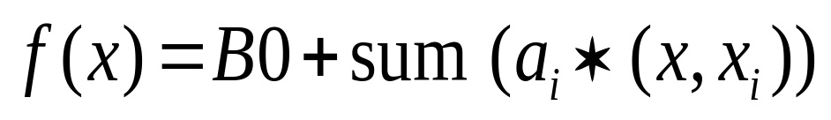

Support Vector Machine algorithm
The equation for making a prediction for a new input using the dot product between the input (x) and each support vector (xi) is calculated as follows:
This is an equation that involves calculating the inner products of a new input vector (x) with all support vectors in training data.
The coefficients B0 and (for each input) must be estimated from the training data by the learning algorithm.

Slide 7
Support Vector Machine algorithm
Linear Kernel SVM
  The dot-product is called the kernel and can be re-written as:
    K(x, xi) = sum(x * xi)
The kernel defines the similarity or a distance measure between new data and the support vectors. The dot product is the similarity measure used for linear SVM or a linear kernel because the distance is a linear combination of the inputs.
Other kernels can be used that transform the input space into higher dimensions such as a Polynomial Kernel and a Radial Kernel. This is called the Kernel Trick.

Slide 8
Support Vector Machine algorithm
It is desirable to use more complex kernels as it allows lines to separate the classes that are curved or even more complex. This in turn can lead to more accurate classifiers.
Polynomial Kernel SVM
Instead of the dot-product, we can use a polynomial kernel, for example:
    K(x,xi) = 1 + sum(x * xi)^d
    Where the degree of the polynomial must be specified by hand to the learning algorithm.
    When d=1 this is the same as the linear kernel.
    The polynomial kernel allows for curved lines in the input space.

Slide 9
Radial Kernel SVM
Finally, we can also have a more complex radial kernel.
For example:
  K(x,xi) = exp(-gamma * sum((x – xi^2))
  Where gamma is a parameter that must be specified to the learning algorithm. A good default value for gamma is 0.1, where gamma is often 0 < gamma < 1.
  The radial kernel is very local and can create complex regions within the feature space, like closed polygons in two-dimensional space.

Slide 10
Data Preparation for SVM
Numerical Inputs: SVM assumes that your inputs are numeric. If you have categorical inputs you may need to covert them to binary dummy variables (one variable for each category).
Binary Classification: Basic SVM is intended for binary (two-class) classification problems. Although, extensions have been developed for regression and multi-class classification.

Slide 11
How does SVM work?
Let’s imagine we have two ags: red and blue, and our data has two features: x and y. We want a classifier that, given a pair of (x,y) coordinates, outputs if it’s either red or blue. We plot our already labeled training data on a plane:

Slide 12
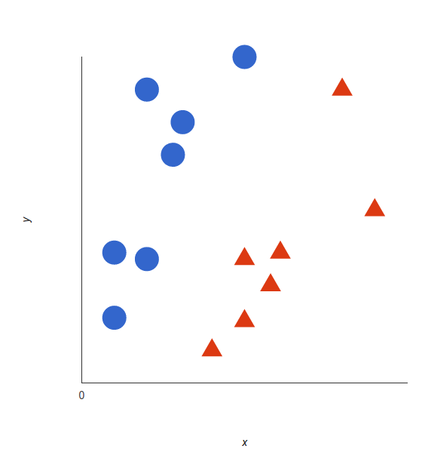
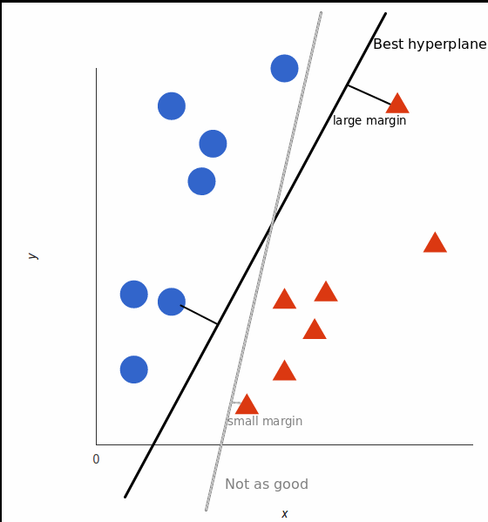
Labelled Data
A support vector machine takes these data points and outputs the hyperplane (which in two dimensions it’s simply a line) that best separates the tags. This line is the decision boundary: anything that falls to one side of it we will classify as blue, and anything that falls to the other as red.

Slide 13
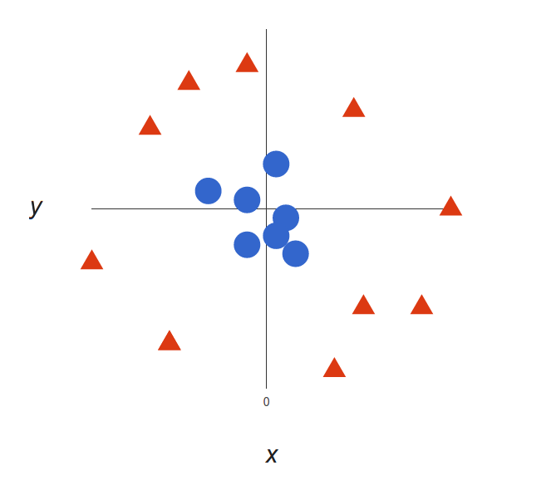
SVM
But, what exactly is the best hyperplane? For SVM, it’s the one that maximizes the margins from both tags. In other words: the hyperplane (remember it’s a line in this case) whose distance to the nearest element of each tag is the largest.
For Nonlinear data

Slide 14
SVM
clear that there’s not a linear decision boundary (a single straight line that separates both tags). However, the vectors are very clearly segregated and it looks as though it should be easy to separate them.
So here’s what we’ll do: we will add a third dimension. Up until now we had two dimensions: x and y.
We create a new z dimension, and we rule that it be calculated a certain way that is convenient for us:
z = x² + y² (you’ll notice that’s the equation for a circle).

Slide 15
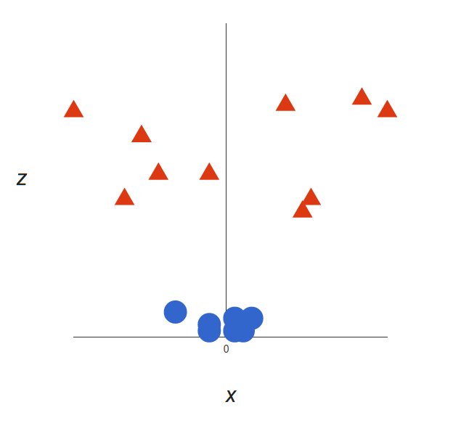
SVM
This will give us a three-dimensional space. Taking a slice of that space, it looks like this:
What can SVM do with this? Let’s see:
Note that since we are in three dimensions now, the hyperplane is a plane parallel to the x axis at a certain z (let’s say z = 1).

Slide 16
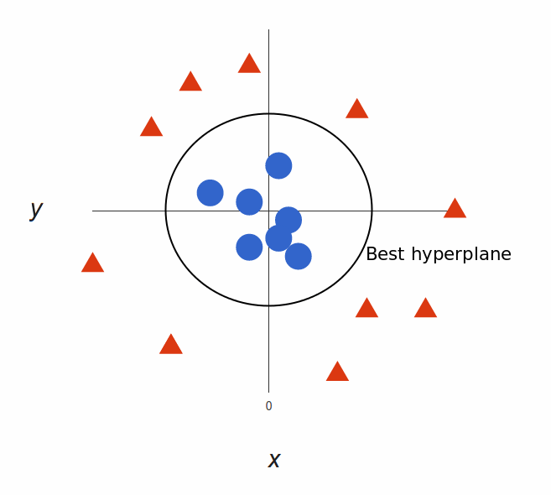
SVM
Our decision boundary is a circumference of radius 1, which separates both tags using SVM.
Video based Presentation

Slide 17


